Slide 1
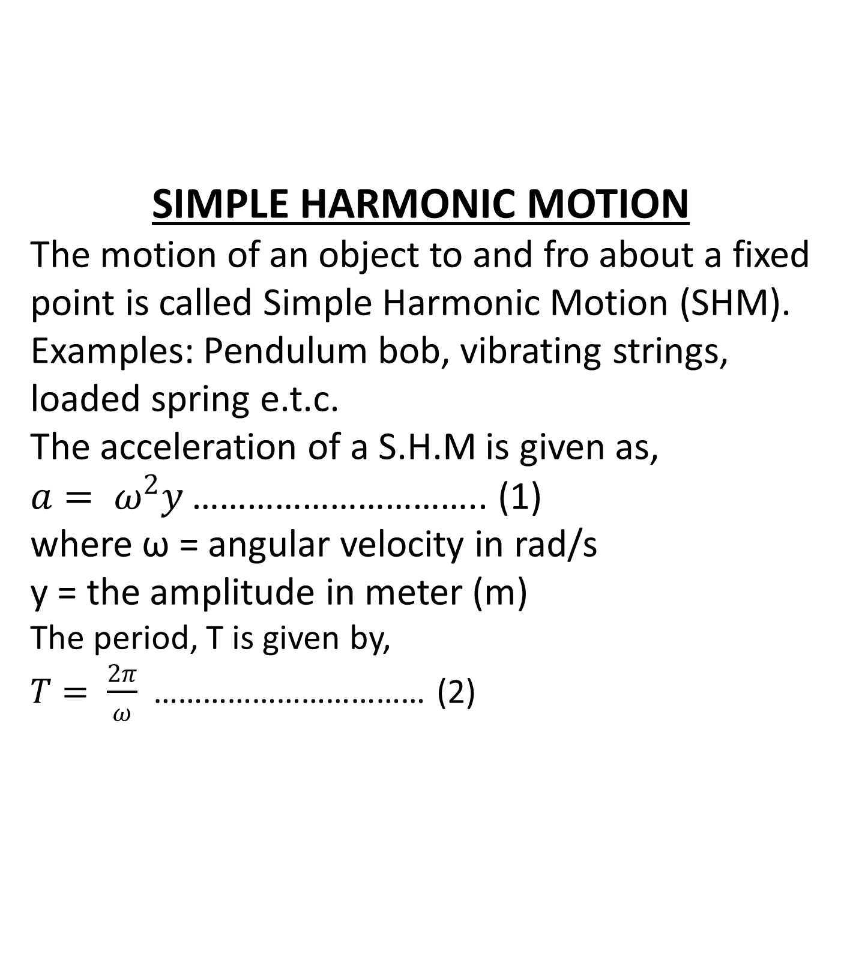
SIMPLE HARMONIC MOTION The motion of an object to and fro about a fixed point is called Simple Harmonic Motion (SHM). Examples: Pendulum bob, vibrating strings, loaded spring e.t.c. The acceleration of a S.H.M is given as, $a= ω^{2}y$ ………………………….. (1) where ω = angular velocity in rad/s y = the amplitude in meter (m) The period, T is given by, $T= \frac{2π}{ω}$ …………………………… (2)

Slide 2
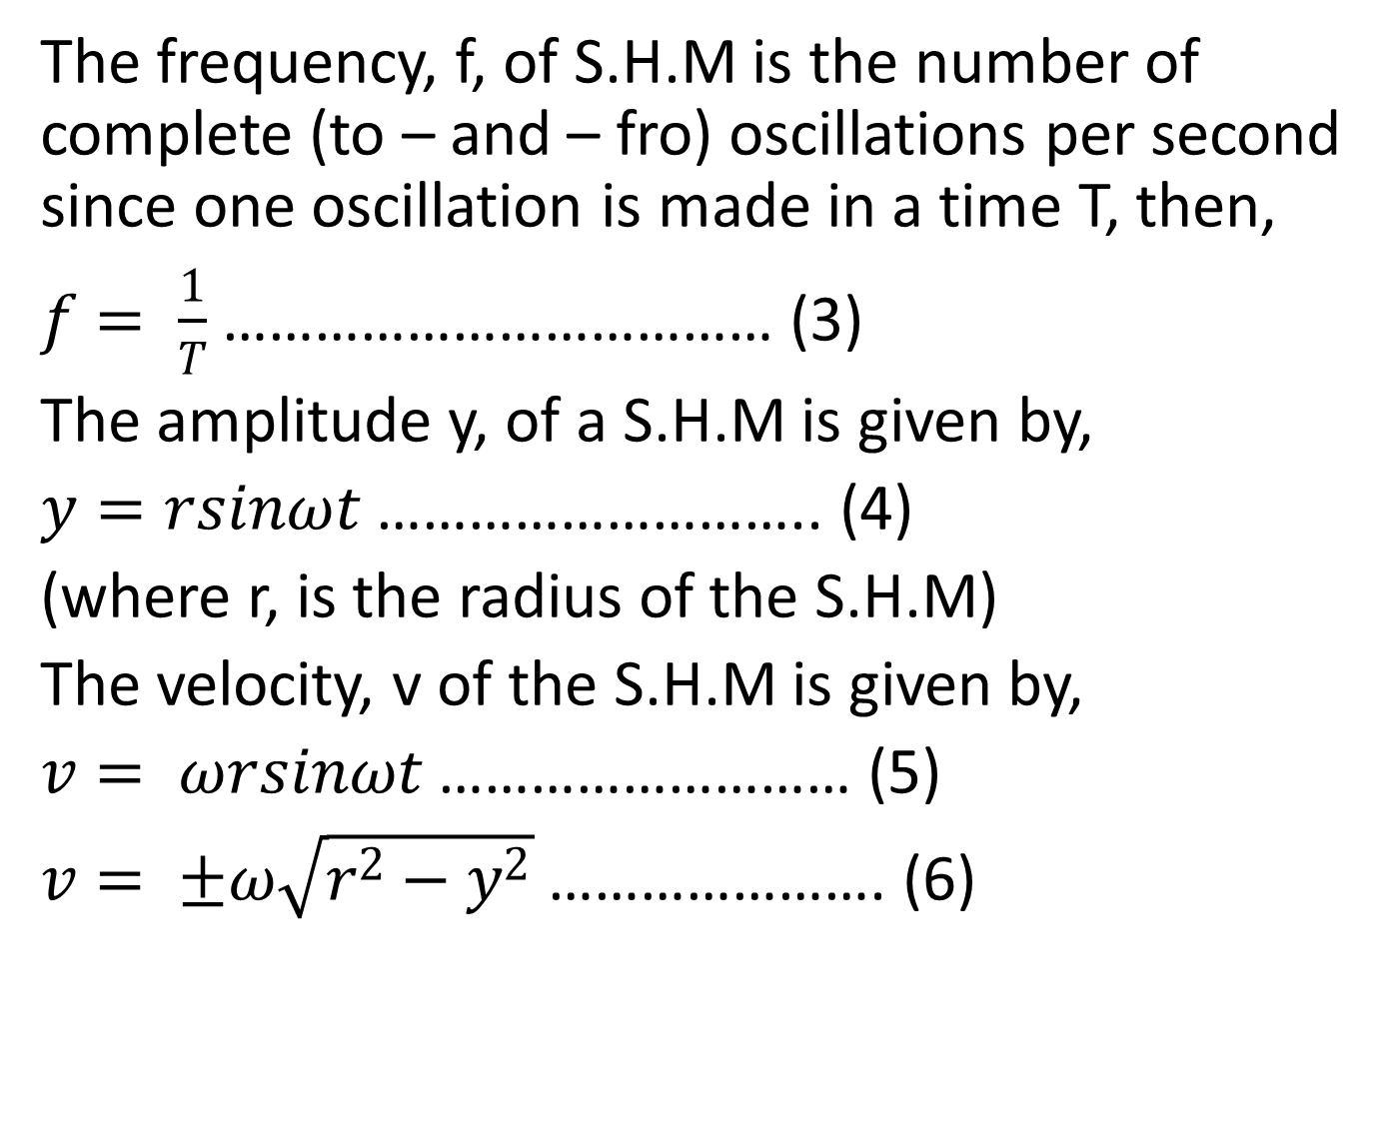
The frequency, f, of S.H.M is the number of complete (to – and – fro) oscillations per second since one oscillation is made in a time T, then,
$f= \frac{1}{T}$ ……………………………… (3)
The amplitude y, of a S.H.M is given by,
$y=rsinωt$ ……………………….. (4)
(where r, is the radius of the S.H.M)
The velocity, v of the S.H.M is given by,
$v= ωrsinωt$ ……………………… (5)
$v= ±ω\sqrt{r^{2}−y^{2}}$ …………………. (6)

Slide 3
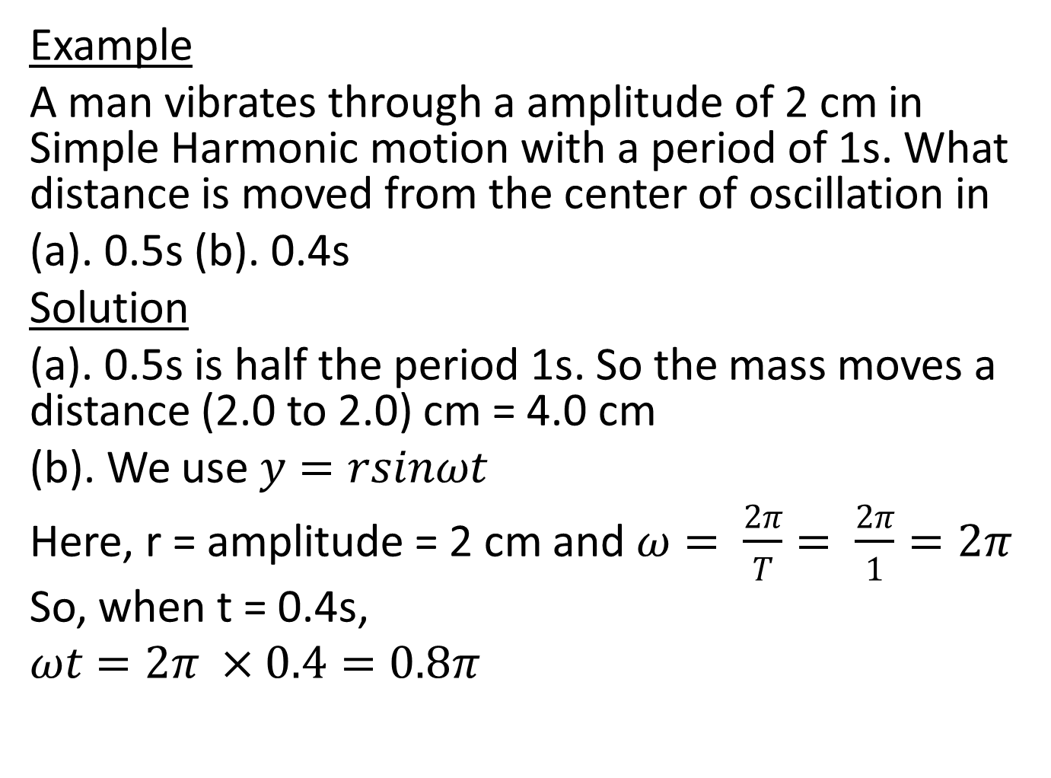
Example
A man vibrates through a amplitude of 2 cm in Simple Harmonic motion with a period of 1s. What distance is moved from the center of oscillation in
(a). 0.5s (b). 0.4s
Solution
(a). 0.5s is half the period 1s. So the mass moves a distance (2.0 to 2.0) cm = 4.0 cm
(b). We use $y=rsinωt$
Here, r = amplitude = 2 cm and $ω= \frac{2π}{T}= \frac{2π}{1}=2π$
So, when t = 0.4s,
$$ωt=2π ×0.4=0.8π$$

Slide 4

Now, $πrad= {180}^{0}$ ,
So $,$
$0.8π × {180}^{0}$ = 144⁰
Hence,
$$y=rsinωt$$
$=2sin{144}^{0}$
$=1.2 cm$

Slide 5
TUTORIALS
(1). An object moving with Simple Harmonic Motion has an amplitude of 0.02 m and a frequency of 20 Hz. Calculate,
(a). the period of oscillation
(b). the acceleration at the middle and end of an oscillation
(c). the velocity at the corresponding instants
(2). A body of mass 0.2 Kg is executing Simple Harmonic Motion with amplitude of 20 cm. The maximum force which acts upon it is 0.064 N. Calculate,
(a). Its maximum velocity
(b). Its period of oscillation

